Slide 1
Mean Shift
Mean Shift is a non-parametric clustering algorithm used in machine learning
Mean Shift clustering aims to discover blobs in a smooth density of samples.
It is a centroid based algorithm, which works by updating candidates for centroids to be the mean of the points within a given region.
These candidates are then filtered in a post-processing stage to eliminate near-duplicates to form the final set of centroids.
Mean Shift doesn't require you to specify the number of clusters beforehand, making it a useful algorithm when the number of clusters is not known in advance.

Slide 2
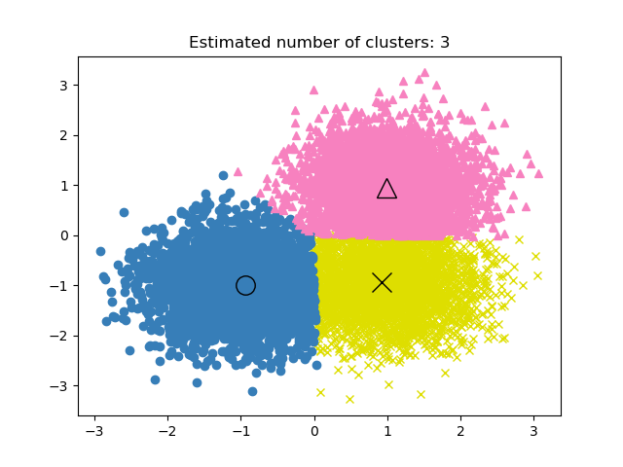
Mean Shift Diagram

Slide 3
The algorithm automatically sets the number of clusters, instead of relying on a parameter Bandwidth which dictates the size of the region to search through.
This parameter can be set manually, but can be estimated using the provided Estimate Bandwidth function, which is called if the bandwidth is not set.
It's particularly effective for density-based clustering, where it identifies areas of high data point concentration.
The algorithm is not highly scalable, as it requires multiple nearest neighbor searches during the execution of the algorithm.
The algorithm is guaranteed to converge, however the algorithm will stop iterating when the change in centroids is small.

